Slide 1

CORE TOPICS

Slide 2





ACTIVITIES
INTENT
EVENT MENU

Slide 3
ACTIVITIES
The Activity class is a crucial component of an Android app
Unlike programming paradigms in which apps are launched with a main() method.
The Android system initiates code in an Activity instance by invoking specific callback methods that correspond to specific stages of its lifecycle.

Slide 4
ACTIVITIES
Most apps contain multiple screens, which means they comprise multiple activities. Typically, one activity in an app is specified as the main activity, which is the first screen to appear when the user launches the app.
Each activity can then start another activity in order to perform different actions.
For example, the main activity in a simple e-mail app may provide the screen that shows an e-mail inbox. From there, the main activity might launch other activities that provide screens for tasks like writing e- mails and opening individual e-mails.

Slide 5
ACTIVITIES
Although activities work together to form a cohesive user experience in an app, each activity is only loosely bound to the other activities
There are usually minimal dependencies among the activities in an app
Activities often start up activities belonging to other apps. For example, a browser app might launch the Share activity of a social-media app.

Slide 6
ACTIVITIES LIFECYCLE
Over the course of its lifetime, an activity goes through a number of states. You use a series of callbacks to handle transitions between states. The following sections introduce these callbacks.

Slide 7
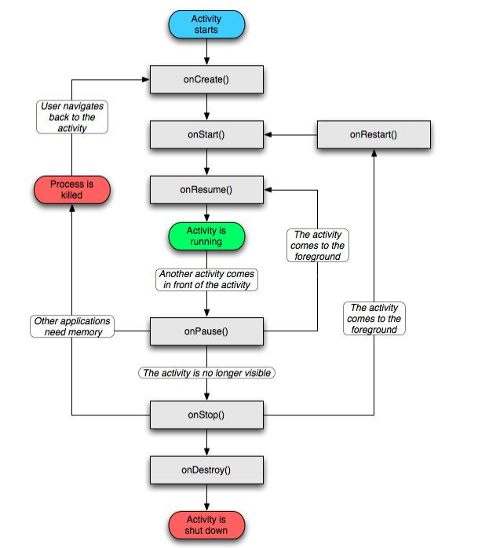
ACTIVITIES LIFECYCLE

Slide 8
OnCreate()
You must implement this callback, which fires when the system creates your activity. Your implementation should initialize the essential components of your activity: For example, your app should create views and bind data to lists here. Most importantly, this is where you must call setContentView() to define the layout for the activity's user interface.
When onCreate() finishes, the next callback is always onStart().

Slide 9
OnStart()
As onCreate() exits, the activity enters the Started state, and the activity becomes visible to the user.
This callback contains what amounts to the activity’s final preparations for coming to the foreground and becoming interactive.

Slide 10
OnResume()
The system invokes this callback just before the activity starts interacting with the user. At this point, the activity is at the top of the activity stack, and captures all user input. Most of an app’s core functionality is implemented in the onResume() method.
The onPause() callback always follows onResume().

Slide 11
OnPause()
The system calls onPause() when the activity loses focus and enters a Paused state. This state occurs when, for example, the user taps the Back or Recents button.
When the system calls onPause() for your activity, it technically means your activity is still partially visible, but most often is an indication that the user is leaving the activity, and the activity will soon enter the Stopped or Resumed state.
An activity in the Paused state may continue to update the UI if the user is expecting the UI to update.

Slide 12
OnPause()
Examples of such an activity include one showing a navigation map screen or a media player playing.
Even if such activities lose focus, the user expects their UI to continue updating.
You should not use onPause() to save application or user data, make network calls, or execute database transactions. For information about saving data, see Saving and restoring activity state.
Once onPause() finishes executing, the next callback is either onStop() or onResume(), depending on what happens after the activity enters the Paused state.

Slide 13
OnStop()
The system calls onStop() when the activity is no longer visible to the user. This may happen because the activity is being destroyed, a new activity is starting, or an existing activity is entering a Resumed state and is covering the stopped activity. In all of these cases, the stopped activity is no longer visible at all.
The next callback that the system calls is either onRestart(), if the activity is coming back to interact with the user, or by onDestroy() if this activity is completely terminating.

Slide 14
OnRestart()
The system invokes this callback when an activity in the Stopped state is about to restart. onRestart() restores the state of the activity from the time that it was stopped.
This callback is always followed by onStart().

Slide 15
OnDestroy()
The system invokes this callback before an activity is destroyed.
This callback is the final one that the activity receives. onDestroy() is usually implemented to ensure that all of an activity’s resources are released when the activity, or the process containing it, is destroyed.

Slide 16
ACTIVITIES
INTENT
EVENT MENU

Slide 17
INTENT
Intent is a messaging object you can use to request an action from another app component. Although intents facilitate communication between components in several ways, there are three fundamental use cases

Slide 18
INTENT
Starting an activity
You can start a new instance of an Activity by passing an Intent to startActivity()
Starting a service
A Service is a component that performs operations in the background without a user interface. With Android 5.0 (API level 21) and later, you can start a service with JobScheduler

Slide 19
INTENT
Delivering a broadcast
A broadcast is a message that any app can receive. The system delivers various broadcasts for system events, such as when the system boots up or the device starts charging. You can deliver a broadcast to other apps by passing an Intent to sendBroadcast() or sendOrderedBroadcast()

Slide 20
INTENT TYPES
Explicit intents
You'll typically use an explicit intent to start a component in your own app, because you know the class name of the activity or service you want to start. For example, you might start a new activity within your app in response to a user action, or start a service to download a file in the background.

Slide 21
INTENT TYPES
Implicit intents
declare a general action to perform, which allows a component from another app to handle it. For example, if you want to show the user a location on a map, you can use an implicit intent to request that another capable app show a specified location on a map

Slide 22
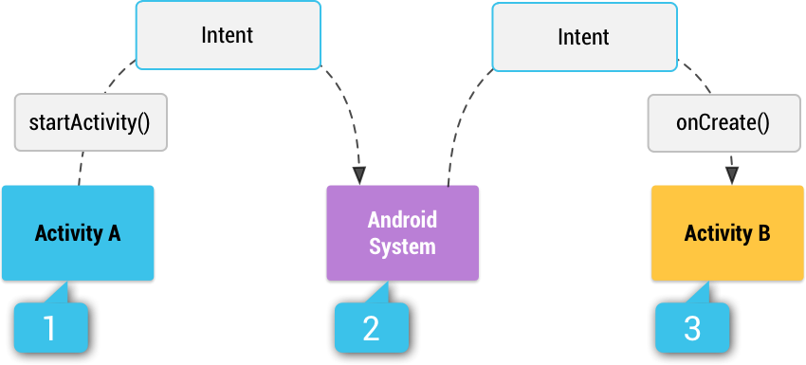
INTENT

Slide 23
ACTIVITIES
INTENT
EVENT MENU

Slide 24
MENU
Menus are a common user interface component in many types of applications. To provide a familiar and consistent user experience, you should use the Menu APIs to present user actions and other options in your activities.

Slide 25
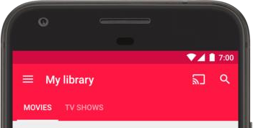
OPTION MENU
the primary collection of menu items for an activity. It's where you should place actions that have a global impact on the app, such as "Search," "Compose email," and "Settings."

Slide 26
CONTEXT MENU
A context menu is a floating menu that appears when the user performs a long-click on an element. It provides actions that affect the selected content or context frame.
The contextual action mode displays action items that affect the selected content in a bar at the top of the screen and allows the user to select multiple items.

Slide 27
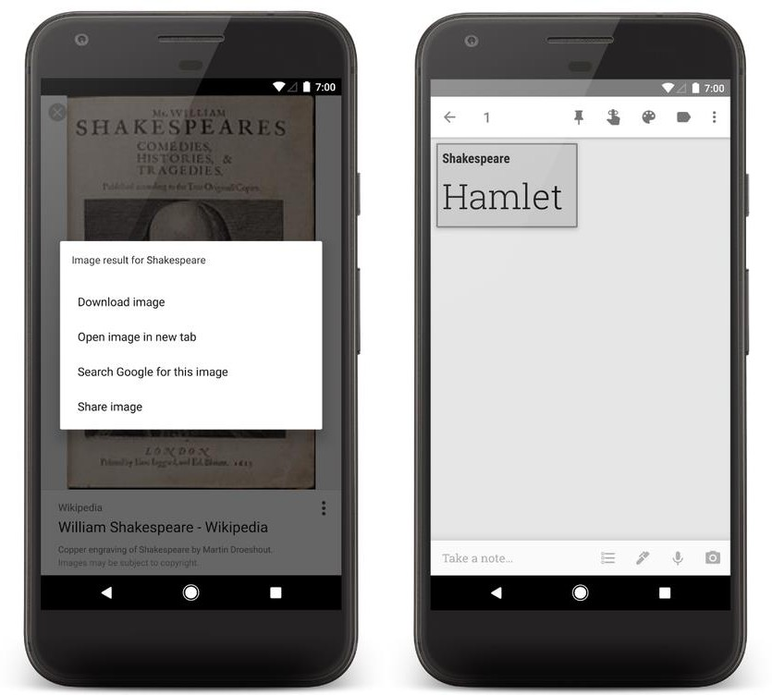
CONTEXT MENU

Slide 28
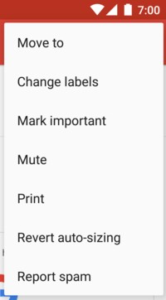
POPUP MENU
A popup menu displays a list of items in a vertical list that's anchored to the view that invoked the menu.

Slide 29
QUESTION
&
THANK YOU FOR YOUR ATTENTION

